Slide 1
Neural Networks And Deep Learning.
SKIN LESION CLASSIFICATION USING CONVOLUTIONAL NEURAL NETWORKS.
Paper: https://ieeexplore.ieee.org/document/9873756 Published : 31 July 2022
Yashwanth Polneni
700753997

Slide 2
INTRODUCTION
Skin cancer is defined as the abnormal growth of skin cells that is most often developed on skin exposed to the sun, primarily the areas of the scalp, face, lips, ears, neck, chest, arms, hands, and legs. It affects people of all skin tones, including those with darker complexions. It represents a major public health concern as it affects many people around the world.
Lesion analysis is vital in medicine. The healthcare industry collects vast amounts of data from patient studies, appointments, and hospital visits, which can reveal crucial insights about illnesses. Analyzing data on malignant pigmented lesions, for example, aids early skin cancer detection, potentially reducing mortality by enabling timely interventions to mitigate or eliminate cancer.

Slide 3
Motivation.
The motivation is to develop an effective neural network for skin lesion diagnosis using the dataset.
The aim is to make a meaningful contribution to the field of dermatological image analysis and to improve the tools available for skin cancer diagnosis.
The goal is to contribute to the advancement of automated skin lesion diagnosis methods, ultimately aiming for better clinical outcomes and efficiency in dermatological assessments.

Slide 4
OBJECTIVE
To develop a convolutional neural network to accurately classify pigmented skin lesions in dermoscopic images to detect the malignant skin lesions as early as possible

Slide 5
Problem Statement.
The task is to develop an automated algorithm for skin lesion diagnosis using a dataset of 10,000 images, each belonging to one of seven image-level classes.
The challenge is to accurately classify these images while addressing significant issues such as class imbalance within the dataset.
The problem is to overcome these challenges by developing a deep learning-based solution that can effectively distinguish between the seven classes of skin lesions, ultimately improving the accuracy of automated skin lesion diagnosis systems​.

Slide 6
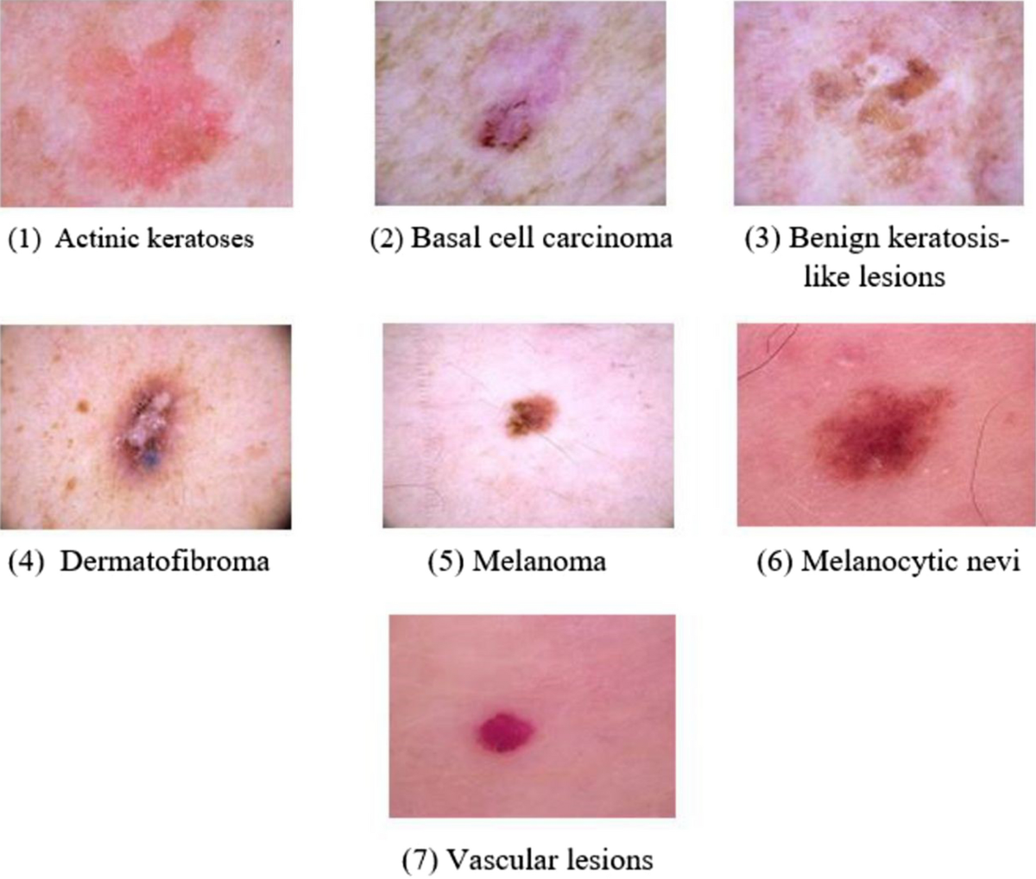
The 7 different diagnostic skin lesion categories to be predicted are:
Melanocytic nevi
Melanoma
Benign keratosis-like lesions
Basal cell carcinoma
Actinic keratoses
Vascular lesions
Dermatofibroma

Slide 7
MODELS USED:
Basic Convolutional Neural Network (CNN) Implementation : A CNN is a class of deep neural networks that comprise of FC feed forward neural networks and utilize convolution in place of general matrix multiplication in at least one of their layers.
InceptionV3 : It is a 48-layered model that was initially introduced during the ImageNet recognition challenge in 2015
ResNet152V2 : is a 152-layered residual neural network (ResNet) developed by Microsoft’s research team. It builds on constructs known from pyramidal cells in the cerebral cortex, by skipping connections or jumping over layers
VGG16: is a 16-layered CNN model that utilizes an architecture of increasing depths with very small convolution filters

Slide 8
Dataset Used:
The data set used in this paper was “The HAM10000 dataset, a large collection of multi-source dermoscopic images of common pigmented skin lesions”. It consisted of 10,015 dermoscopic skin pigmented lesion 600 by 450 pixel images, digitized and stored as JPEG images.
The data set included 7 attributes associated with each image and patient, which were:
• Patient’s Age [age] • Patient’s Sex [sex] • A Lesion ID [lesion id] • An Image ID [image id] • A Technical Validation Field Type [dx type] • The Localization of the Skin Lesion [localization] • A Diagnostic Skin Lesion Category [dx]

Slide 9
Data Pre-Processing
Importing Essential Libraries
Creating Classes and Defining Functions
Creating a Dictionary of Images and their Labels
Importing Dataset
Reading & Processing Dataset
Cleaning Dataset
Exploratory Dataset Analysis (EDA)
Processing & Resizing Images
Features and Target Split
Target One-Hot Encoding
Training, Validation, and Test Split
Feature Normalization
Reshaping Images
Data Augmentation
Models Evaluations
Calculate Training and Validation Sets Accuracy + Loss + Errors
Summarize Models Accuracy + Loss + RMSE + MSE against Epochs (Plot the Models History)
Calculate Testing Set Accuracy + Loss + Errors
Testing Set Confusion Matrix for True vs Predicted Labels
Generate a Confusion Matrix Classification Report
Find Out Which Skin Lesion Category had the Most Accurate Label Classification

Slide 10
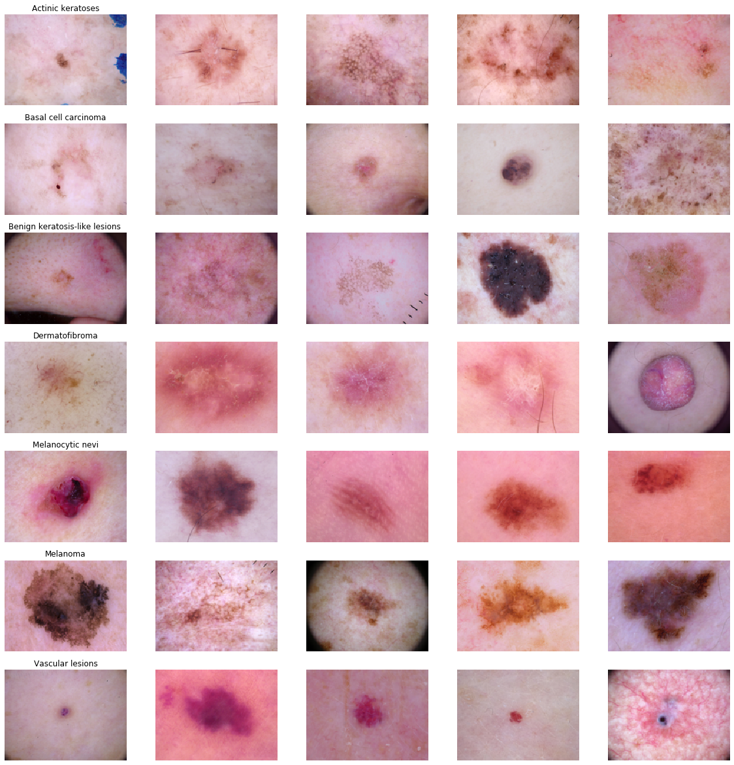

Slide 11
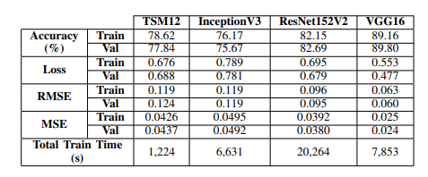
Model training and Validation

Slide 12
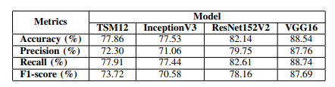
Model Performance on Testing Set

Slide 13
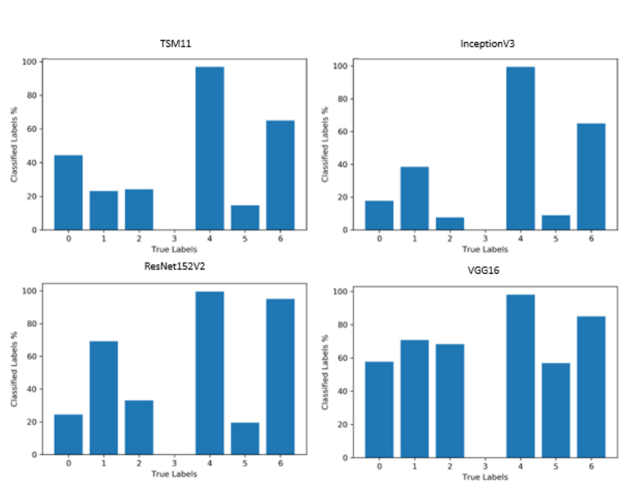
Model Classification Accuracy Plots:

Slide 14
Conclusion:
Investigated CNN architectures for skin lesion classification, including custom-built TSM12 and pre-trained models (InceptionV3, ResNet152V2, VGG16).
Data preprocessing involved cleaning, feature normalization, data augmentation, and weighted classes to handle imbalance.
VGG16 achieved top metrics:
Accuracy: 88.54% Precision: 87.76% Recall: 88.74% F1-score: 87.69%
TSM12 performed comparably to InceptionV3 and ResNet152V2, showing strong potential.
More malignant lesion images needed for improved malignancy classification.
Highlights CNNs’ potential in medical imaging for early detection and disease classification.

Slide 15
Future Work:
Explore other class imbalance techniques to improve the skin lesion category classifications for classes that are underrepresented.
Utilize all the data in this data set, such as age and sex, via other machine learning techniques to extract useful information that can be combined with the work demonstrated in this paper.
Explore other skin lesion data sets to obtain more training data to feed into our models, specially for the underrepresented and malignant skin lesion classes. • Explore other pre-trained CNN models.
Enhance TSM12’s architecture and implementation, by further tuning hyperparameters, such as the number of layers, the type of layers and the layers’ hyperparameter values.

Slide 16
References:
] P. Canada, ”Skin cancer - Canada.ca”, Canada.ca, 2020. [Online]. Available: https://www.canada.ca/en/public-health/services/sun-safety/skin-cancer.html.
[2] Artificial intelligence in medicine:Machine learning.” [Online]. Available: https://www.ibm.com/watson-health/learn/artificial-intelligence-medicine
[3] P. Tschandl, C. Rosendahl and H. Kittler, ”The HAM10000 dataset, a large collection of multi-source dermatoscopic images of common pigmented skin lesions”, Scientific Data, vol. 5, no. 1, 2018. Available: 10.1038/sdata.2018.161.
[4] ”A Comprehensive Guide to Convolutional Neural Networks—the ELI5 way”, Medium, 2020. [Online]. Available: https://towardsdatascience.com/a-comprehensive-guide-to-convolutionalneural-networks-the-eli5-way-3bd2b1164a53.

